Slide 1

Preparing Physicians to Care for People with Disabilities:
Core Competencies and the ADA
Susan M. Havercamp, PhD, FAAIDD, NADD-CC
The Ohio State University Nisonger Center

Slide 2

Ohio State University Nisonger Center
University Center for Excellence providing the highest quality interdisciplinary training, clinical care, and research to support the inclusion of
people with developmental disabilities
in all aspects of community life.
Ohio Disability and Health Partnership
With CDC funding, improve the health and quality of life of Ohioans with disabilities.

Slide 3
Objectives
Learners will recognize:
Although overall healthcare is improving, health inequities exist for disadvantaged groups, including Americans with disabilities.
The Americans with Disabilities Act requires health care entities to provide full and equal access for people with disabilities through reasonable accommodations, effective communication, and accessible facilities.

Slide 4
Improvements in population health and health equity depend on
training the health care workforce
to provide care across populations [1]

Slide 5
The World Health Organization defines disability as denoting impairments of body functions and structure, limitations in activity, and
participation restrictions. [2]

Slide 6
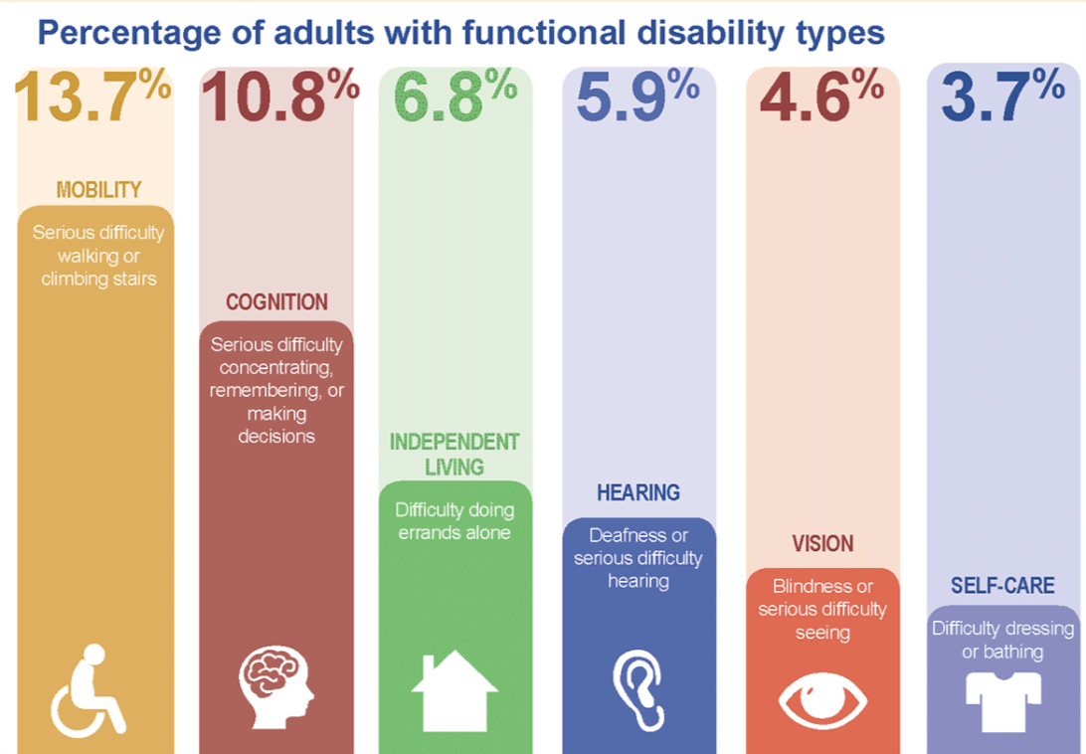
CDC Disability and Health Data System (2018)
26% of adults in the U.S. has a disability [3]

Slide 7
At 26% of the population, people with disabilities represent the largest minority group in the country,
yet the health care system is not prepared to meet their needs

Slide 8
People with disabilities
Overrepresented in health care system
  health needs related to disabling condition
  high rates of chronic health conditions [4]
Despite the high need for health care, people with disabilities report barriers to quality care [5]

Slide 9
World Report on Disability
People with disabilities report
poor access to healthcare compared to people without disabilities
high rates of unmet healthcare needs
dissatisfaction with the healthcare they receive [6]

Slide 10
People with disabilities were more than as likely to report finding healthcare provider skills inadequate to meet their needs [6].
twice

Slide 11
People with disabilities were nearly times more likely to report being denied care [6].
three

Slide 12
People with disabilities were more than times more likely to report being treated badly [6].
four

Slide 13
Health care providers
Report feeling uncomfortable and unprepared,
significant training gaps contribute to health care disparities [7]

Slide 14
Health Care Providers tend to
Underestimate the size and diversity of the disability population
Underestimate the health, and quality of life of people of disabilities
Hold inaccurate assumptions about current/future functional status
Overlook cultural, economic, social determinants of health
Overlook health issues not having to do with the disability

Slide 15
Many Doctors Have Negative Perceptions of Patients with Disabilities- And That Impacts Quality of Care, Study Finds [14]
For the disabled, a doctor’s visit can be literally an obstacle course- and the laws can’t help [16]
Among 714 physicians... [14]
82.4% reported that people with significant disability have worse quality of life
Only 40.7% percent were very confident about their ability to provide the same quality of care to patients with disability
Just 56.5% strongly agreed that they welcomed patients with disability into their practices
Study Finds Many Doctors Unaware of Their Legal Duties to Treat People with Disabilities [15-16]

Slide 16



Because health care providers across all disciplines will likely encounter people with disabilities in their practice, it is important for every clinician to be comfortable and competent in treating this population. [5]
Physicians seeing 25 patients per day will treat about 7 patients with disabilities every day

Slide 17
What are training barriers?
Inclusion of disability content has relied on the advocacy efforts of individual champions in health education [17]
Constraints on time and resources,
competing priorities
School accreditation requirements and professional licensure exams lack disability
Lack of systemic organizing framework

Slide 18
Lack of systemic organizing framework
Innovative disability curricula have been developed, evaluated, and published [8-13]
Learning objectives, curricular content, and evaluation measures were developed independently for each.
Agreement on what to teach about disability remains has not been reached

Slide 19
Milestones toward Disability- Competent Healthcare Workforce [18]
Collectively decide what health care providers need to understand about disability (core competencies)
Change training and licensure requirements to ensure students receive disability training
Develop evidence-based curricula
Develop robust protocols to evaluate disability competence
Evaluate the impact of disability training on the delivery of disability-competent care and the impact of competent care on patient health outcomes
Explore health care delivery models and incentive structures to promote disability competent care

Slide 20
Competency-based education
allows us to develop learning objectives based on the health needs of the community, people with disabilities.
The first step is to explicitly map the specific health needs of people with disabilities to a set of competencies for the workforce in training [19]

Slide 21
Alliance for Disability in Health Care Education
Asked, What do health care professionals
need to understand about disability to provide
quality care to patients with disabilities?”
2. Competency = desired knowledge, skills, and behaviors required to successfully perform the healthcare role.
3. Drafted core competencies on disability
See Alliance website, www.adhce.org
Notes:
people with disabilities have all sorts of health needs, like everyone else
Therefore, to address health disparities, ALL healthcare providers must be trained to care for PWD
The Alliance asked, “What is it that providers need to know about disability?”
Alliance drafted core competencies that were designed for ALL health disciplines and ALL types of disabilities
Competencies = learning objectives that are used to develop curricula

Slide 22
The Ohio Disability and Health Partnership Sought Broader Input [20]
Individuals with Disabilities
Family Members
National Delphi process
Disability Advocates
Consensus
Health Educators
Healthcare Professionals
Disability Professionals
go.osu.edu/disabilitycompetencies
Notes:
We recruited a large diverse group of stakeholders to review and give feedback on the draft competencies
We revised competencies based on feedback and sent them back to group in an iterative process
Until group agreed that
they reflected what health care providers need to know to care for patients with disabilities

Slide 23

Disability stakeholder consensus
See
https://go.osu.edu/corecompetenciesdisability-learnmore

Slide 24
objectives
The six core competencies define the standard for disability training to improve healthcare for people with disabilities [20]
Contextual and Conceptual Framework on Disabilities
Legal Obligations and Responsibilities
Professionalism and Patient-Centered Care
Teams and Systems Based Practice
Clinical Care over the Lifespan and during Transitions
Clinical Assessment
Notes:
Hi! Each button is a hyperlink that will take you to the corresponding slide. Each slide has a hyperlink that will take you to this “home” slide

Slide 25

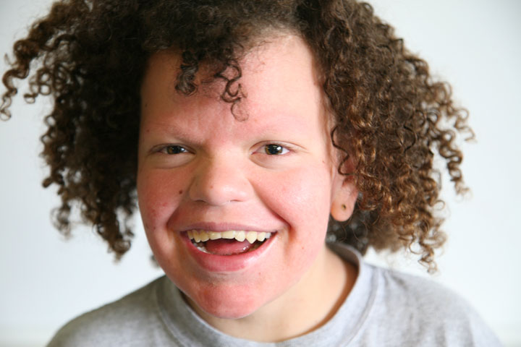
Contextual and Conceptual Framework of Disabilities
Learners will acquire a conceptual framework of disability in the context of human diversity, the lifespan, wellness, injury and social and cultural environments.
Notes:
Shift from disability as illness to be prevented and treated to
Disability is a functional limitation that may or may not impact health and quality of life, an aspect of diversity

Slide 26
Contextual and Conceptual Framework
Describe the civil rights and independent living history of people with disabilities and their access to services. Understand how such history has both informed current thinking and improved access to care and equal rights for people with disabilities.
Describe how social determinants of health directly impact people with disabilities (e.g., discrimination, employment, education, transportation, housing, poverty, access to healthcare).

Slide 27

Learners will demonstrate mastery of general principles of professionalism, communication, respect for patients and recognize optimal health and quality of life from the patient’s perspective
Professionalism and Patient-Centered Care

Slide 28
Professionalism and patient-centered care
Demonstrate communication strategies to best meet the needs of the patient. Seek out and implement appropriate resources, including interpreter services, to communicate effectively using clear language at an appropriate level of health literacy. Adjust schedule to allow extra time as needed.
Discuss issues of trust, confidence, and confidentiality with patients who receive support with personal care during health care encounters related to their disability.

Slide 29

Teams and Systems Based Practice
Learners will engage and collaborate with team members within and outside their own discipline to provide high quality, interprofessional team-based health care to people with disabilities

Slide 30
Teams and systems based practice
Demonstrate skills in teamwork including flexibility, adaptability, open communication, assertiveness, conflict management, referral, use of evidence-based practice to support decision-making and mutual goal-setting with patients with disabilities and other team members.

Slide 31

Good clinical management requires that accurate and relevant information about the health and function of patients with disabilities is viewed in the context of the person’s life activities, goals, and interests. It is essential to consider a patient’s disability as well and their language, race, ethnicity, sexual orientation, gender, gender identity and expression, health literacy and other cultural factors in clinical assessment.
Clinical Assessment

Slide 32
Clinical Assessment
Respond competently to a patient’s language, race, ethnicity, sexual orientation, gender, gender identify and expression, health literacy, and other cultural factors.
Apply strategies or supports that could be used in a healthcare setting to accommodate patients with functional limitations

Slide 33

Patients with disabilities may require supports and accommodations to benefit fully from clinical intervention. Transitions across the lifespan may be similar yet differ in terms of opportunities, needed supports, or services for people with disabilities.
Clinical Care over the Lifespan and during Transitions

Slide 34
Clinical Care over the lifespan and during Transitions
Tailor recommended supports and interventions to the patient’s cultural beliefs and values, time, resources, and preferences. Be prepared to propose constructive solutions to possible conflicts between patient, caregivers, and other professionals about goals and treatments.
Demonstrate skill in identifying, coordinating, referring, and advocating for access to community and health care resources needed to support treatment plan objectives.

Slide 35

Health care professionals must meet the
Learners will understand their legal requirements for providing health care in a manner that is, at minimum, consistent with federal laws such as the Americans with Disabilities Act (ADA), Rehabilitation Act, and Affordable Care Act to meet the individual needs of people with disabilities.
Legal Obligations and Responsibilities

Slide 36
Accommodations are
civil rights, not merely the right thing to do

Slide 37
Doctors think...
Myth - A doctor who does not specialize in a patient’s disability does not have to provide care to that person.
Myth - Patients who want sign language translators can be expected to make those arrangements and pay for them
Myth – The ADA is not my responsibility in private practice/ in leased space

Slide 38
The ADA requires that health care entities provide full and equal access to people with disabilities
This can be done through:
Reasonable Modifications of Policies, Practices, and Procedures
Effective Communication. Making communication, in all forms, easily understood
Accessible Facilities. Ensuring physical accessibility

Slide 39
Providers must ensure that communication with patients with hearing, vision, and speech disabilities are as effective as communication with other patients
Provide qualified sign language interpreter for patients who request this
For a person with low vision, providing a qualified reader for written information and providing post- op discharge instructions and medication management in large print
Digital accessibility is also required for effective communication

Slide 40
Legal Obligations and Responsibilities
Identify the physical access requirements (e.g., accessible exam table, mammography equipment, etc.) of the ADA, Rehabilitation Act, and related laws and policies that apply to health and the provision of health care.
Ensure that healthcare providers and support staff members are trained to provide services that meet the needs of the patient with a disability (e.g., knowing how to appropriately transfer a patient with a mobility limitation to an exam table).

Slide 41
Accommodation examples:
When scheduling, ask all patients if they require any accommodations or assistance to fully participate in care. Note responses in chart.
Granting an early appointment and allowing the patient to go directly to the exam room to avoid the waiting room
Assisting a person with a mobility disability onto the exam table
Sending intake paperwork to the patient in an accessible format to be completed independently before appointment
Scheduling extra time for exams with patients whose disability requires it

Slide 42
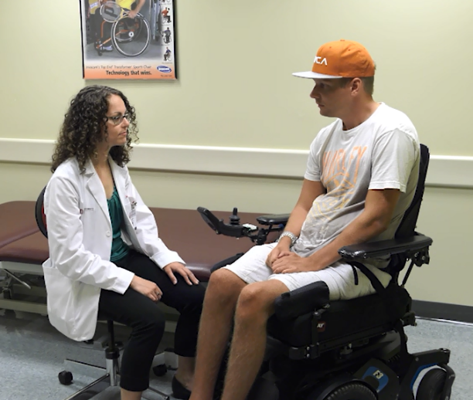
Students Value Disability Training Opportunities
More Comfortable with Patients
“I am more comfortable and less awkward when seeing patients with disabilities because I learned it doesn't have to be the focus of the encounter.”

Slide 43

Students Recognize Personal Bias
“I think it is easy to make certain assumptions, consciously or subconsciously, about people with disabilities that can only really be dispelled by interacting with
individuals with disabilities.”

Slide 44
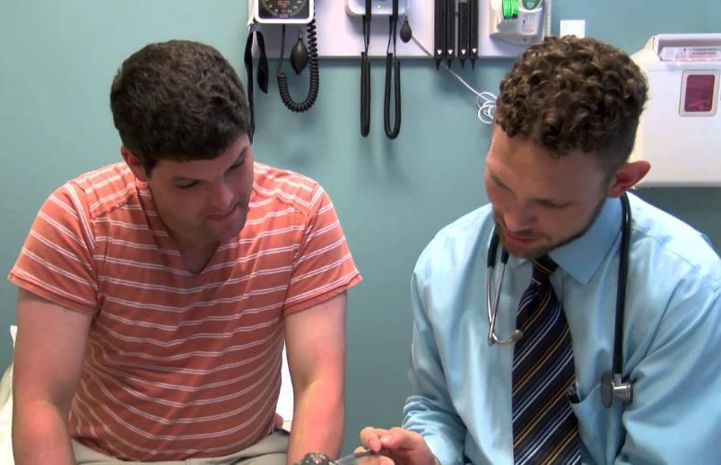
Increased Understanding
“The best takeaway that I had
from the encounter was that people with disabilities want their medical concerns to be addressed in a direct and straightforward way just like any other patient. ”

Slide 45
Nothing About Us Without Us

Slide 46
Disability Resources for
Health Care Providers

Slide 47
Fact Sheets
ADA National Network, Health Care and the Americans with Disabilities Act, https://adata.org/factsheet/health-care-and-ada
Pacific ADA Center, Health Care and the ADA, https://www.adapacific.org/healthcare
US Department of Justice, Access to Medical Care for Individuals with Mobility Disabilities, https://www.ada.gov/medcare_mobility_ta/medcare_ta.htm
U.S. Department of Justice, ADA Requirements: Effective Communication, https://www.ada.gov/effective-comm.htm

Slide 48
Fact Sheets
Centers for Disease Control and Prevention, Disability and Health Information for Health Care Providers, https://www.cdc.gov/ncbddd/disabilityandhealth/hcp.html
American Foundation for the Blind, ADA Checklist: Ensuring Access to Services and Facilities by Patients who are blind, deaf-blind, or visually impaired, https://www.afb.org/blindness-and-low-vision/your-rights/advocacy-resources/ada-checklist-health-care-facilities-and
American Medical Association, Access to care for patients with disabilities Strategies for ensuring a safe, accessible, and ADA compliant practice, https://www.ama-assn.org/media/24926/download

Slide 49
Online Training
State University of New York, Disability Integration Toolkit, https://www.upstate.edu/pmr/education/toolkit/index.php
Ohio State University Nisonger Center, Disability Trainings for Healthcare Providers, https://nisonger.osu.edu/education-training/ohio-disability-health-program/disability-healthcare-training/
American Foundation for the Blind, Serving the Needs of Individuals with Visual Impairments in the Healthcare Settings, https://www.afb.org/research-and-initiatives/serving-needs-individuals-visual-impairments-healthcare-setting
Centers for Disease Control and Prevention, Mark’s story, https://www.youtube.com/watch?v=4D_wsryhBXY

Slide 50

We Must Include Disability Competencies in Professional Standards for Accreditation and Licensure

Slide 51

Thank you!

Slide 52
Funding Acknowledgement
The Ohio Disability and Health Program is supported by the Centers for Disease Control and Prevention Cooperative Agreement Number NU27DD000032. The contents of this presentation are solely the responsibility of the authors and do not necessarily represent the official views of the Centers for Disease Control and Prevention.

Slide 53
References
We are grateful to Rick Guidotti and PositiveExposure for the beautiful photographs used in this presentation, https://positiveexposure.org/
Frenk, J., Chen, L., Bhutta, Z. A., Cohen, J., Crisp, N., Evans, T., ... & Zurayk, H. (2010). Health professionals for a new century: transforming education to strengthen health systems in an interdependent world. The lancet, 376(975 (6), 1923-1958.
World Health Organization(2001). ICF: International Classification of Functioning, Disability and Health.
Centers for Disease Control and Prevention (2018). Disability Impacts All of Us infographic, https://www.cdc.gov/ncbddd/disabilityandhealth/infographic-disability-impacts-all.html

Slide 54
Reichard, A. Stolzle, H. Fox, M.H. (2011). Health disparities among adults with physical disabilities or cognitive limitations compared to individuals with no disabilities in the United States. Disability and Health Journal, 4 (2), 10.1016/j.dhjo.2010.05.003
Shakespeare, T. (2012). Still a health issue. Disability and Health Journal, 5(3).
World Health Organization [and] The World Bank. (2011). World report on disability. Geneva, Switzerland :World Health Organization. Available at https://www.who.int/publications/i/item/world-report-on-disability www.who.int

Slide 55
Ankam, N. S., Bosques, G., Sauter, C., Stiens, S., Therattil, M., Williams, F. H., ... & Mayer, R. S. (2019). Competency-based curriculum development to meet the needs of people with disabilities: A call to action. Academic medicine, 94(6), 781-788.
L.I. Iezzoni, L.M. Long-Bellil (2012). Training physicians about caring for persons with disabilities: “Nothing about us without us!” Disability and Health Journal, 5, pp. 136-139
A. Duggan, Y.S. Bradshaw, S.E. Carroll, S.H. Rattigan, W. Altman(2009).What can I learn from this interaction? A qualitative analysis of medical student self-reflection and learning in a standardized patient exercise about disability. J Health Commun, 14 (8) (2009), pp. 797-811

Slide 56
Symons, A.B. McGuigan, D. Akl, E.A. (2009). A curriculum to teach medical students to care for people with disabilities: development and initial implementation. BMC Med Educ, 9 (1) (2009), p. 78
L.M. Long-Bellil, K.L. Robey, C.L. Graham, et al. (2011). Teaching medical students about disability: the use of standardized patients. Acad Med, 86 (9) (2011), pp. 1163-1170
L.J. Woodard, S.M. Havercamp, K.K. Zwygart, E.A. Perkins (2009). An innovative clerkship module focused on patients with disabilities. Acad Med, 87 (4) (2012), pp. 537-542
P. Bu, J.J. Veloski, N.S. Ankam. (2016). Effects of a brief curricular intervention on medical students’ attitudes toward people with disabilities in healthcare settings. Am. J. Phys. Med. Rehabil., 95 (12) (2016), pp. 939-945

Slide 57
Iezzoni, L. I., Rao, S. R., Ressalam, J., Bolcic-Jankovic, D., Agaronnik, N. D., Donelan, K., ... & Campbell, E. G. (2021). Physicians’ Perceptions Of People With Disability And Their Health Care: Study reports the results of a survey of physicians' perceptions of people with disability. Health Affairs, 40(2), 297-306.
Agaronnik, N. D., Pendo, E., Campbell, E. G., Ressalam, J., & Iezzoni, L. I. (2019). Knowledge of practicing physicians about their legal obligations when caring for patients with disability. Health affairs, 38(4), 545-553.
Ordway, A., Garbaccio, C., Richardson, M., Matrone, K., & Johnson, K. L. (2021). Health care access and the Americans with Disabilities Act: A mixed methods study. Disability and Health Journal, 14(1), 100967.

Slide 58
Seidel, E. & Crowe, S. (2017). The state of disability awareness in American medical schools. Am. J. Phys. Med. Rehabil., 96 (9), pp. 673-676
Neil Bowen, C., Havercamp, S. M., Bowen, S. K., & Nye, G. (2020). A call to action: Preparing a disability-competent health care workforce. Disability and Health Journal, 13(4), 100941.
L.D. Gruppen, R.S. Mangrulkar, J.C. Kolars. (2012). The promise of competency-based education in the health professions for improving global health. Hum Resour Health, 10 (1) (2012), 10.1186/1478-4491-10-43
Havercamp, S. M., Barnhart, W. R., Robinson, A. C., & Smith, C. N. W. (2021). What should we teach about disability? National consensus on disability competencies for health care education. Disability and health journal, 14(2), 100989.

Slide 59
Alliance for Disability in Health Care Education (2019). Core Competencies for Disability in Health Care Education. Peapack, NJ. Alliance for Disability in Health Care Education. http://www.adhce.org.

